Slide 1
MKTG 571:
Customer Metrics
An Introduction

Slide 2
Today’s Agenda
To discuss a broad range of marketing metrics which have all been related positively to firm value
To discuss how to select metrics and give examples of which ones firms use
To discuss the results of the Decision Tree assignment

Slide 3
Customer Metrics
“You can’t manage what you don’t measure”
Why are metrics important?
Which metrics should a firm use?
How many metrics should a firm use?

Slide 4
Customer Metrics
Metric types:
  Aggregate (store-level) vs. Individual (customer-level)
  Unobservable vs. Observable
Metric Categories:
  Brand Value
  Customer Value
  Word of Mouth and Referral Value
  Retention and Acquisition
  Cross-buying and Up-buying
  Multi-channel Shopping
  Product Returns

Slide 5
Brand Metrics
What is Brand Equity/Brand Value?
  It is the positive differential effect that knowing the brand name has on customer response to the product or service.
  It is a measure of the brand’s ability to capture consumer preference and loyalty.
What are the top brands worth?

Slide 6
Brand Metrics
Aggregate: Brand Equity
How do we measure brand equity?
Brandz
Apple ($183 B)
IBM ($116 B)
Google ($108 B)
McDonald’s ($95 B)
Microsoft ($77 B)
Coca Cola ($74 B)
Marlboro ($74 B)
AT&T ($69 B)
Verizon ($49 B)
China Mobile ($47 B)
Interbrand
Coca-Cola ($76.8 B)
Apple ($76.5 B)
IBM ($75.5 B)
Google ($70 B)
Microsoft ($58 B)
GE ($44 B)
McDonald’s ($40 B)
Intel ($39 B)
Samsung ($33 B)
Toyota ($30 B)

Slide 7
Brand Metrics
Individual: Brand Value
What is a brand’s value to an individual?
How do we measure it?
  Brand Awareness (Recall & Recognition)
  Brand Image (Characteristics and relationships among brand associations)

Slide 8
Customer Value
Aggregate: Customer Equity (CE)
  Important to link aggregate customer cash flows with firm performance (e.g. shareholder value)
Individual: Customer Lifetime Value (CLV)
  Important to understand (and be able to predict) the cash flows from customers for customer selection and optimal resource allocation.

Slide 9
Wallet Size
Individual: Size of Wallet
  Total category purchases ($)
  Used as a measure of a customer’s potential
Sources of information
  Survey current customers
  Industry estimates and averages

Slide 10
Customer Share Measures
Share of Category Requirements (SCR)
  % of a customer’s purchases in a category that are met by a given brand/firm
  = # Purchases from firm i
  # Total Category Purchases
Share of Wallet
  % of a customer’s $ purchases in a category that are met by a given brand/firm ($ Purchases from firm i)/($Total Category Purchases)
Both are used as measures of customer loyalty
Both can be computed at individual or aggregate level
From internal records
From market and distribution panels

Slide 11
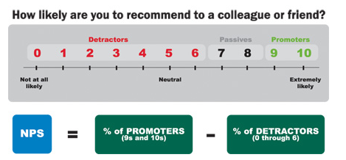
WOM and Referral Value
Aggregate: Net Promoter Score
How do we measure it?
Source: NetPromoter.com

Slide 12
WOM and Referral Value
Individual: Customer Referral Value
  How is it measured?
  How is it related to customer value?
Individual: Business Reference Value
  How is it measured?
  How is it related to customer value?

Slide 13
Customer Acquisition
Aggregate:
Acquisition rate (%) = 100 * Number of prospects acquired Number of prospects targeted
  Denotes average probability of acquiring a customer from a population
  Computed for a group of customers
  Typically computed on a campaign-by-campaign basis
Acquisition cost ($) = Acquisition spending ($)
Number of prospects acquired
  Precise values for firms targeting prospects through direct mail
  Less precise for broadcast communications

Slide 14
Retention, Defection, and Survival
Aggregate:
Retention Rate (%) = 100 * # customers buying in (t)
# customers buying in (t-1)
  Denotes average probability of retaining a customer from one period to the next
  Computed for a group of customers
  Avg. retention rate (%) = [1 – (1/Avg. Lifetime Duration)]
  Avg. Defection Rate (%) = 1 – Avg. Retention rate
Survival Rate_{t} (%) = 100* Retention Rate_{t}* Survival Rate_{t-1}
  Provides a summary measure of how many customers survived between the start of a cohort and any point in time afterwards

Slide 15
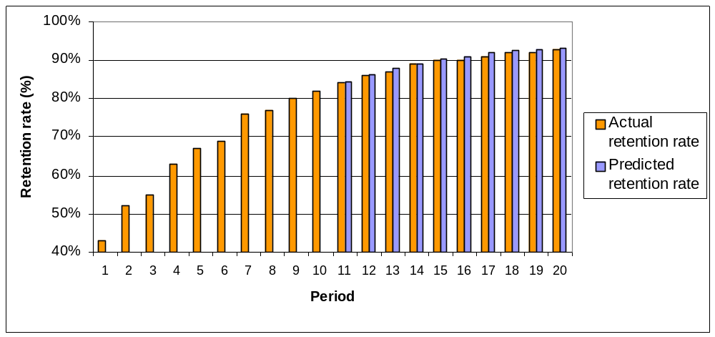
Retention Rates Over Time
Common for retention rates to increase at a decreasing rate
Retention Rates for a Credit Card Company

Slide 16
Retention, Defection, and Survival
Individual:
Contractual
  When are you likely to quit?
  How do you measure/predict it?
Non-contractual
  Probability of being active?
  How do you measure/predict it?

Slide 17
Cross-buying/Up-buying
Aggregate:
  Average # of Categories Purchased
Individual:
  # of Categories Purchased

Slide 18
Multichannel Shopping
Aggregate:
  Average # of channels shopped
  Average time until new channel adoption
Individual:
  # of channels shopped
  Time until new channel adoption

Slide 19
Product Returns
Aggregate:
  Average # (or value) of products returned
  Average product return rate (e.g. 15%)
Individual:
  # (or value) of products returned
  Product return rate (e.g. 15%)

Slide 20
Unobservable Metrics
Customer Satisfaction
Service Quality
Loyalty (Attitudinal)
Intention to Purchase

Slide 21
What do retailers use?
Traffic
Number of
Transactions
Conversion
Percentage
Total Store
Sales
Units per
Transaction
Average Dollars
per Transaction
Average Unit
Retail Price
The Limited’s Model
Source: Petersen et al. (2009)

Slide 22
What do retailers use?
Revenue
Average Order Size =
Revenue/Orders
Revenue
Per Visit
Orders
Visits
Conversions = Orders/Visit
Overstock’s Web Analytics Triangle
Source: Petersen et al. (2009)

Slide 23
Metric Selection
How do we get there?
  Data Capture
  Operationalization
  Measurement Interval
  Tracking
  Experimentation
  Dissemination (e.g. Dashboards)
  Linkages

Slide 24

Predictive Models
Predicting Response at BookBinders:
Decision Trees vs. RFM vs. Logistic

Slide 25
Decision Trees at Bookbinders
Whom to target?
Cumulative gains charts
  Any indication of overfitting?
Profitability Analysis
Comparison of Random, RFM, Logistic, and Decision Trees

Slide 26
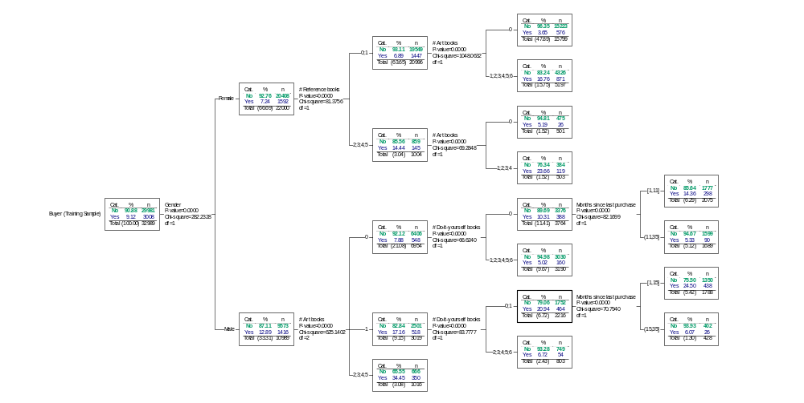
CHAID Tree
Females who have bought at least one art book
5 terminal nodes have % Yes > 8.3%
Males with no art or DIY purchases and whose last purchase was 11 months ago or less
Males who have purchased two or more art books
Males who bought one art and<=1 DIY books and whose last purchase was 15 months ago or less
= terminal node

Slide 27
Cumulative Gains of Training Sample
Training Sample
 |  | Response |  |  | Cum. | Cum.
Customers | Buyers | Rate | Profit | Gains | Gains | Cust.
1016 | 350 | 34.4% | $1,592 | 11.6% | 11.6% | 3.1%
1788 | 438 | 24.5% | $1,734 | 14.6% | 26.2% | 8.5%
503 | 119 | 23.7% | $463 | 4.0% | 30.2% | 10.0%
5197 | 871 | 16.8% | $2,628 | 29.0% | 59.1% | 25.8%
2075 | 298 | 14.4% | $751 | 9.9% | 69.0% | 32.1%
803 | 54 | 6.7% | ($78) | 1.8% | 70.8% | 34.5%
428 | 26 | 6.1% | ($58) | 0.9% | 71.7% | 35.8%
1689 | 90 | 5.3% | ($305) | 3.0% | 74.7% | 40.9%
501 | 26 | 5.2% | ($95) | 0.9% | 75.5% | 42.4%
3190 | 160 | 5.0% | ($635) | 5.3% | 80.9% | 52.1%
15799 | 576 | 3.6% | ($4,444) | 19.1% | 100.0% | 100.0%
32989 | 3008 |  | $1,554

Slide 28
Cumulative Gains of Test Sample
Test Sample
 |  | Response |  |  | Cum. | Cum.
Customers | Buyers | Rate | Profit | Gains | Gains | Cust.
513 | 168 | 32.7% | $752 | 11.1% | 11.1% | 3.0%
244 | 62 | 25.4% | $250 | 4.1% | 15.2% | 4.5%
898 | 208 | 23.2% | $799 | 13.7% | 28.9% | 9.7%
2749 | 431 | 15.7% | $1,212 | 28.5% | 57.4% | 25.9%
1106 | 165 | 14.9% | $437 | 10.9% | 68.3% | 32.4%
239 | 19 | 7.9% | ($6) | 1.3% | 69.6% | 33.8%
895 | 50 | 5.6% | ($148) | 3.3% | 72.9% | 39.1%
401 | 22 | 5.5% | ($69) | 1.5% | 74.3% | 41.4%
1657 | 85 | 5.1% | ($319) | 5.6% | 79.9% | 51.2%
231 | 9 | 3.9% | ($62) | 0.6% | 80.5% | 52.5%
8078 | 295 | 3.7% | ($2,269) | 19.5% | 100.0% | 100.0%
17011 | 1514 |  | $579

Slide 29
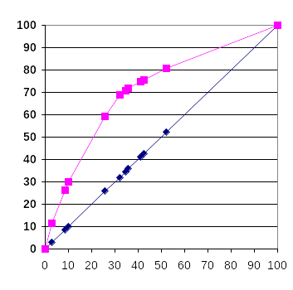
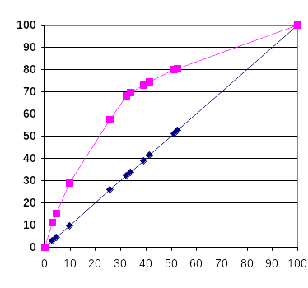
Cumulative Gains
Test Sample
Training Sample

Slide 30
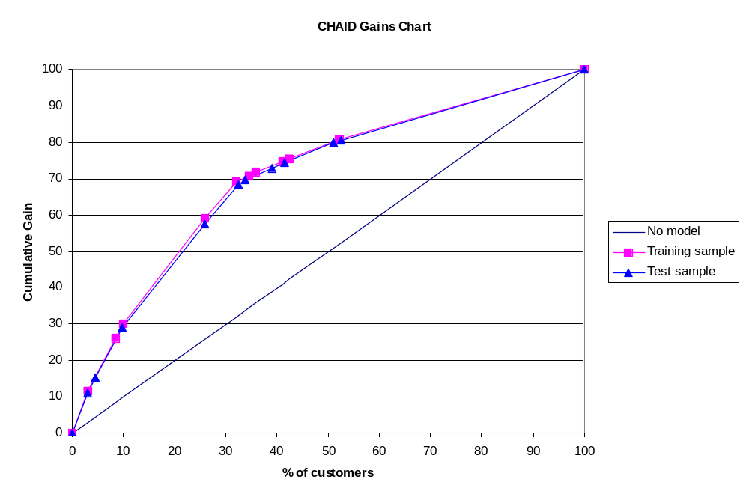
Training and Test Compared

Slide 31
Profitability
Profitability – based on training sample:
  Gross profit $ = 2076 ($6) – 10579($0.5) = $12,456 - $5289.50 = $7166.50
  Gross profit % = $7166.50/ $37,368 = .1918 = 19.18%
  Return on marketing expenditures: $7166.50/$5289.50 = 1.35, or 135%
Profitability – based on test sample:
  Gross profit $ = 1034 ($6) – 5510($0.5) = $6,204 - $2755 = $3449
  Gross profit % = $3449/ $18,612= .1853 = 18.53%
  Return on marketing expenditures: $3449/$2755= 1.25, or 125%
Profitability – based on combined training and test samples:
  Gross Profit $ = 3110 ($6) – 16089 ($0.5) = $18,660 - $8044.5 = $10,615.50
  Gross Profit % = $10615.5/$55980 = 18.96%
  Return on marketing expenditures: $10615.5/$8044.5 = 131.96%

Slide 32
Comparing Model Performance
Profitability Analysis | Mass Mailing | RFM | Logistic | Decision Trees
Number of customers | 50,000 | 50,000 | 50,000 | 50,000
Number mailed | 50,000 | 22,731 | 15,565 | 16,089
% of customers mailed | 100.0% | 45.5% | 31.1% | 32.2%
Number of buyers | 4,522 | 3,214 | 3324 | 3,110
Response Rate | 9.04% | 14.14% | 21.4% | 19.33%
Gross Revenues | $81,396.00 | $57,852.00 | $59,832.00 | $55,980.00
COGS | $40,698.00 | $28,926.00 | $29,916.00 | $27,990.00
Shipping Costs | $13,566.00 | $9,642.00 | $9,972.00 | $9,330.00
Mailing | $25,000.00 | $11,365.50 | $7,782.50 | $8,044.50
Gross Profit | $2,132.00 | $7,918.50 | $12,161.50 | $10,615.50
Gross Profit/Sales | 2.62% | 13.69% | 20.3% | 18.96%
Return on Marketing | 8.53% | 69.67% | 156.3% | 131.96%

Slide 33
Comparing Models
Interpretability and Insights:
  Males more likely to buy (DT)
  Positive effect of prior art book purchases and negative effect of prior DIY purchases (DT)
RFM and Decision Trees group customers
Logistic Regression is for each customer
Costs
  Software, model development

Slide 34
Takeaways: Decision Trees
Advantages
  Readily interpretable
  Generates easy-to-implement rules
  Identifies ‘important’ variables
Limitations
  Can get ‘bushy’
  Requires special ($$$) software
In Practice
  Validation is critical
  Often used to identify important variables and relationships to guide the development of regression models

Slide 35
For Next Class
Topic:
  Managing Customer Metrics
Reading:
  Can Product Returns Make You Money?
Assignment:
  None

